Slide 1
FSM Online Internship
Computer Vision to detect defects in PCB
Keivalya Pandya
Birla Vishvakarma Mahavidyalaya
Under Mentorship of
Mr. Devesh Tarasia
IITD-AIA FOUNDATION FOR SMART MANUFACTURING

Slide 2
Project Background
In the PCB manufacturing industry, one of the most important aspects of production is quality checking. PCB boards go through lots of production processes from panel cutting to laminating and one single defect in a board will make the entire board become obsolete.
Can artificially intelligent systems, where we can make use of Machine Learning and Computer Vision capabilities help us achieve excellence? Let’s find out!
Unique challenges:
Limitation on computing power
Large dataset, increased time complexity
Hardware setup
Deployment storage

Slide 3
Objective
Develop robust algorithm which can detect variety of PCB defects
Taking advantage of OpenCV and Machine Learning to improve production quality
Production line product-inspection
Deploy the model to the web
Testing and reiterating proposed solution
Fine-tuning the parameters over time to achieve better results

Slide 4
Methodology
Defect identification and distinction
Identifying the type of defects need to be extracted in order to make the most efficient algorithm
Exploratory data analysis
Understanding which features would contribute the most towards making better predictions
Making sure that we do not overfit the model
Dividing data into Train, Test and Validation segments
ML model selection
Selecting optimal algorithm for our purposes
Depends upon the deployment scheme that needs to be employed
YOLOv5 environment setup
Setting up required dependencies for the model to work in my local machine
Overcoming GPU limitations turned out to be a challenge
Working with a neural network with 234 layers increases the complexity of the algorithm; however, we do get better results in selective cases
Training the model
Deciding number of epochs that will give decent precision and recall over validation dataset
This involves using the results produced by EDA
Reiterating over epochs and other training parameters
Model will make several errors, identify where it goes wrong and correct the same
Configure the model according to our dataset, EDA findings, and feature selection
Tuning hyperparameters
Setting hyperparameters that work best for us
Usually takes trial-and-error; hence time consuming
Deployment
As the model was focused more upon taking accuracy as a parameter to be optimized the same, spending less time on UI is a reasonable tradeoff
Working on online deployment as well as a real-time offline version
Notes:
Defect extraction
Identifying the type of defects need to be extracted in order to make the most efficient algorithm
Exploratory data analysis
Understanding which features would contribute the most towards making better predictions
Making sure that we do not overfit the model
Dividing data into Train, Test and Validation segments
ML model selection
Selecting optimal algorithm for our purposes
Depends upon the deployment scheme that needs to be employed
YOLOv5 environment setup
Setting up required dependencies for the model to work in my local machine
Overcoming GPU limitations turned out to be a challenge
Working with a neural network with 234 layers increases the complexity of the algorithm; however, we do get better results in selective cases
Training the model
Deciding number of epochs that will give decent precision and recall over validation dataset
This involves using the results produced by EDA
Reiterating over epochs and other training parameters
Model will make several errors, identify where it goes wrong and correct the same
Configure the model according to our dataset, EDA findings, and feature selection
Tuning hyperparameters
Setting hyperparameters that work best for us
Usually takes trial-and-error; hence time consuming
Deployment
As the model was focused more upon taking accuracy as a parameter to be optimized the same, spending less time on UI is a reasonable tradeoff
Working on online deployment as well as a real-time offline version

Slide 5
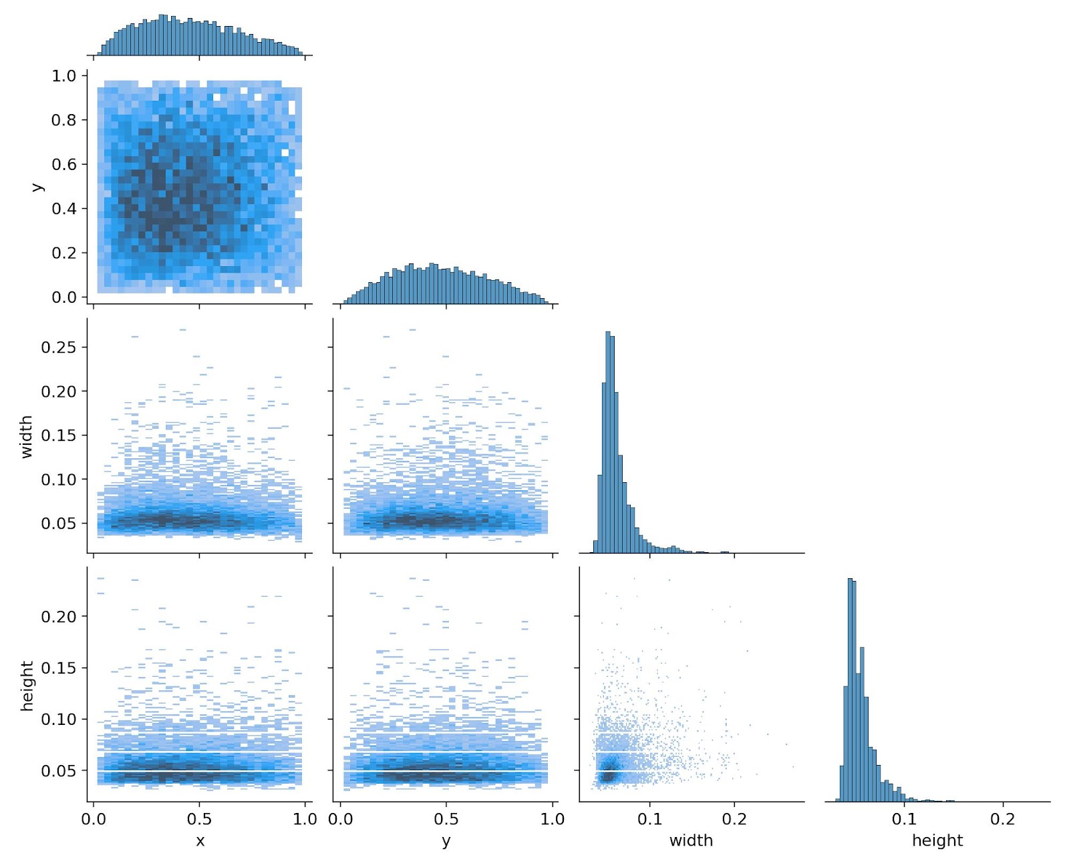
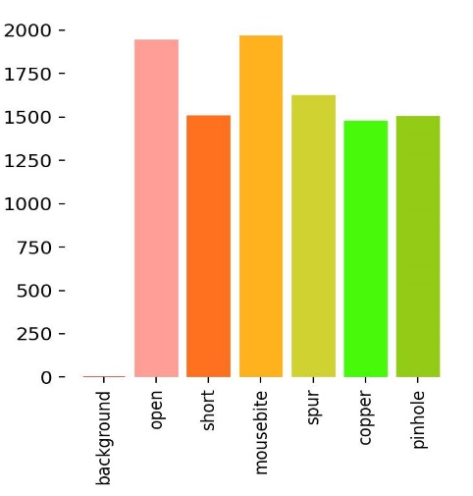
Implementation
The original size of the template and the tested image is around 16k x 16k pixels.
Reduced this to 640 x 640 pixels sub-images, by cropping
Each defect on the tested image is annotated as the format: “x1, y1, x2, y2, type”

Slide 6
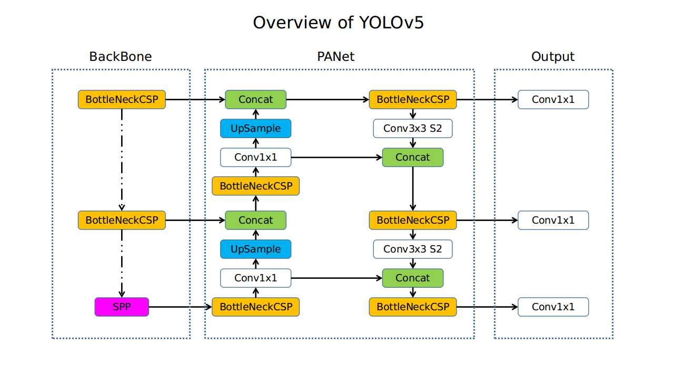
Implementation
The network structure of YOLOv5 is divided into three parts, backbone, neck, and output. In the backbone, the input image with 640×640×3 resolution goes through the Focus structure. Using the slicing operation, it first becomes a 320×320×12 feature map, and then after a convolution operation of 32 convolution kernels, it finally becomes a 320×320×32 feature map. The CBL module is a basic convolution module. A CBL module represents Conv2D + BatchNormal + LeakyRELU.
PCB Fault Detection - INTP2022-ML-3 (pcb-fault-detection.herokuapp.com/docs#)

Slide 7
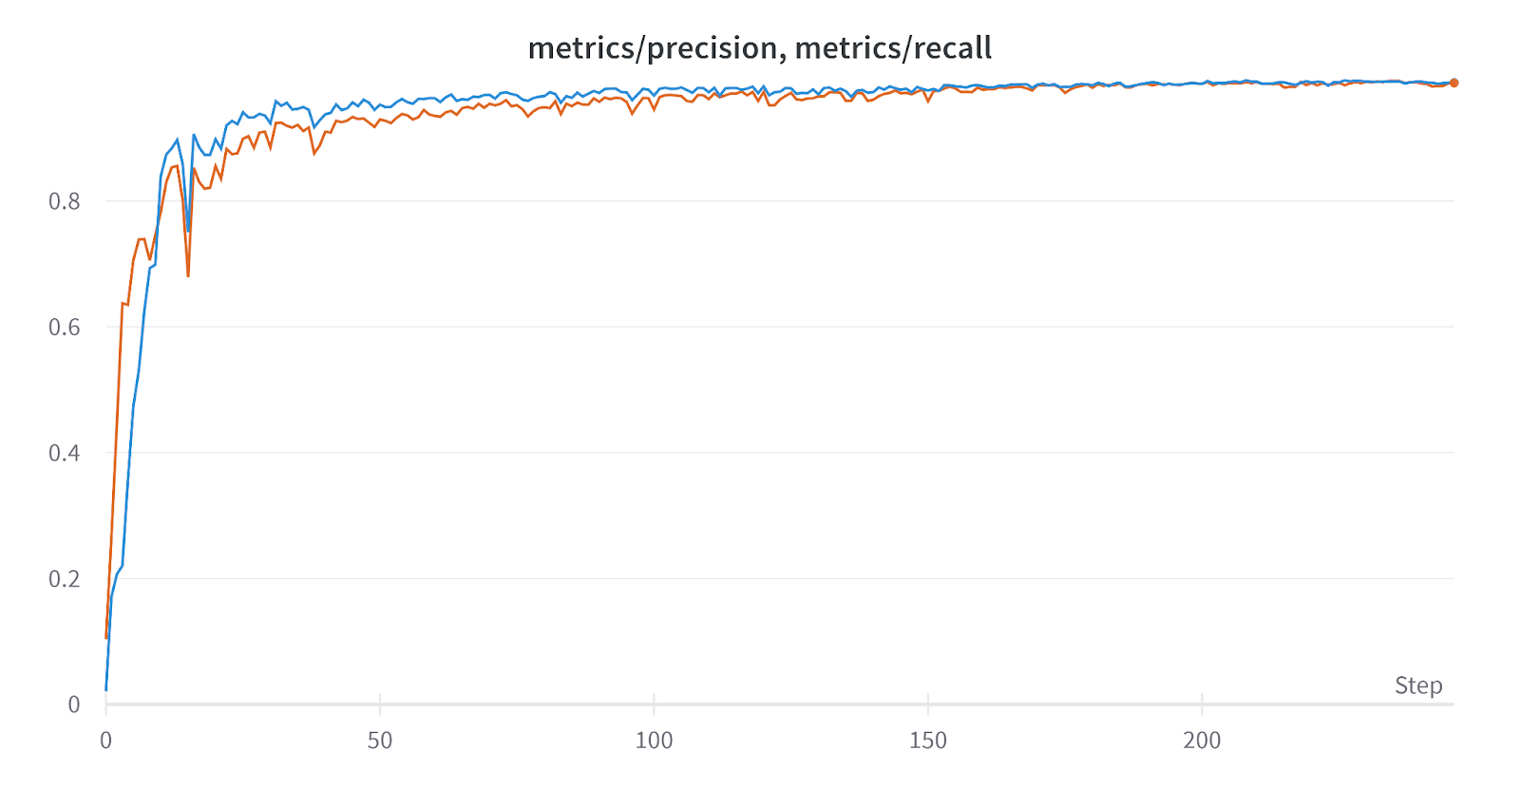
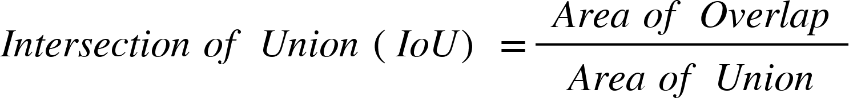
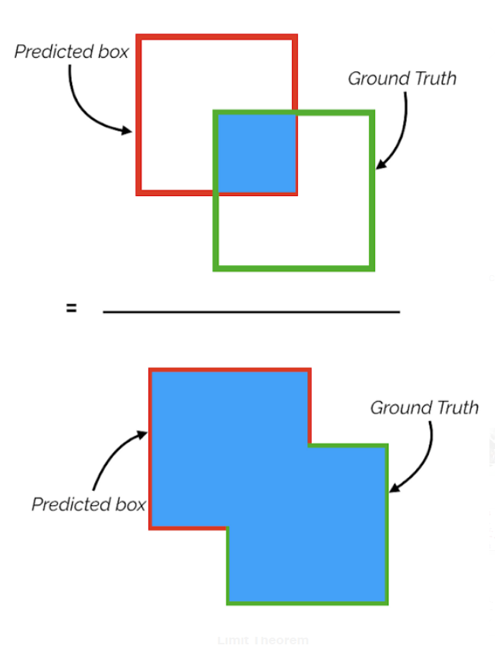
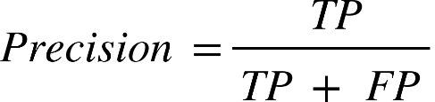
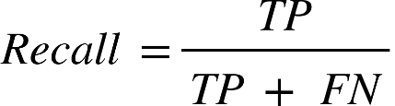
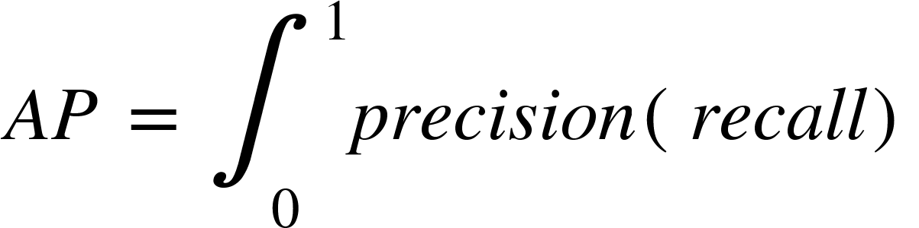
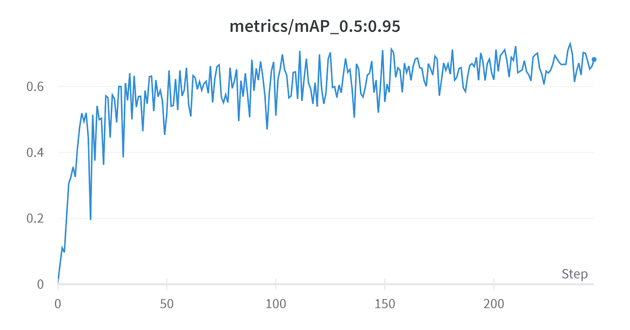
Implementation
Initially, mAP0.5:0.95 is inconsistent, however as the epochs increase, we can see narrower variations in the metrics. This represents the platonic convergence of the criterion and increase in its stability.

Slide 8
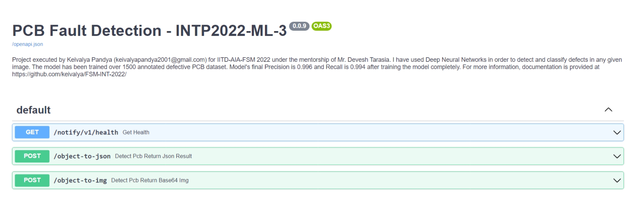
Implementation
Deployment command
PCB Fault Detection - INTP2022-ML-3 (pcb-fault-detection.herokuapp.com/docs#)

Slide 9
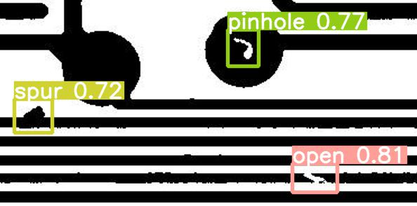
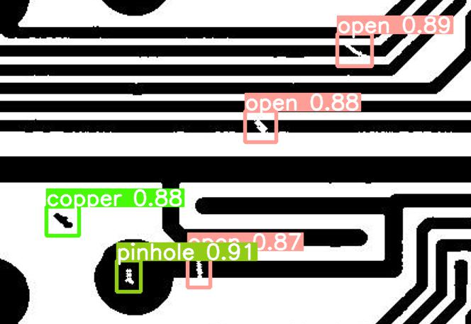
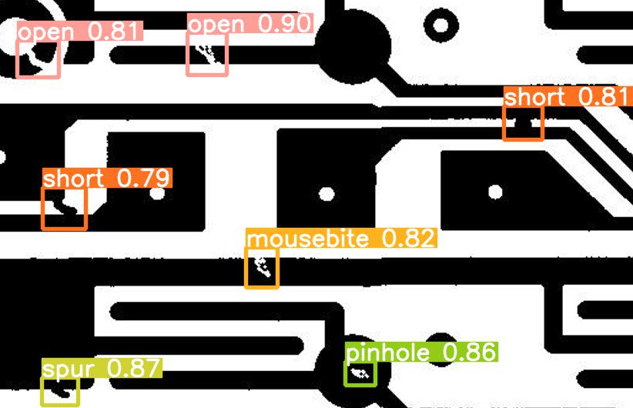
Implementation
Finally, the project has successfully achieved all its desired objectives mentioned across the internship tenure. All the aspects have been implemented elegantly.
Milestones I am proud of:
Achieving 99.6% accuracy
Deploying heavy PyTorch model over the web
Understand deep neural nets and build a marvel out of it
Repeatedly getting praised by my mentor (of course!)
Sample outputs that can be regenerated from the web application

Slide 10
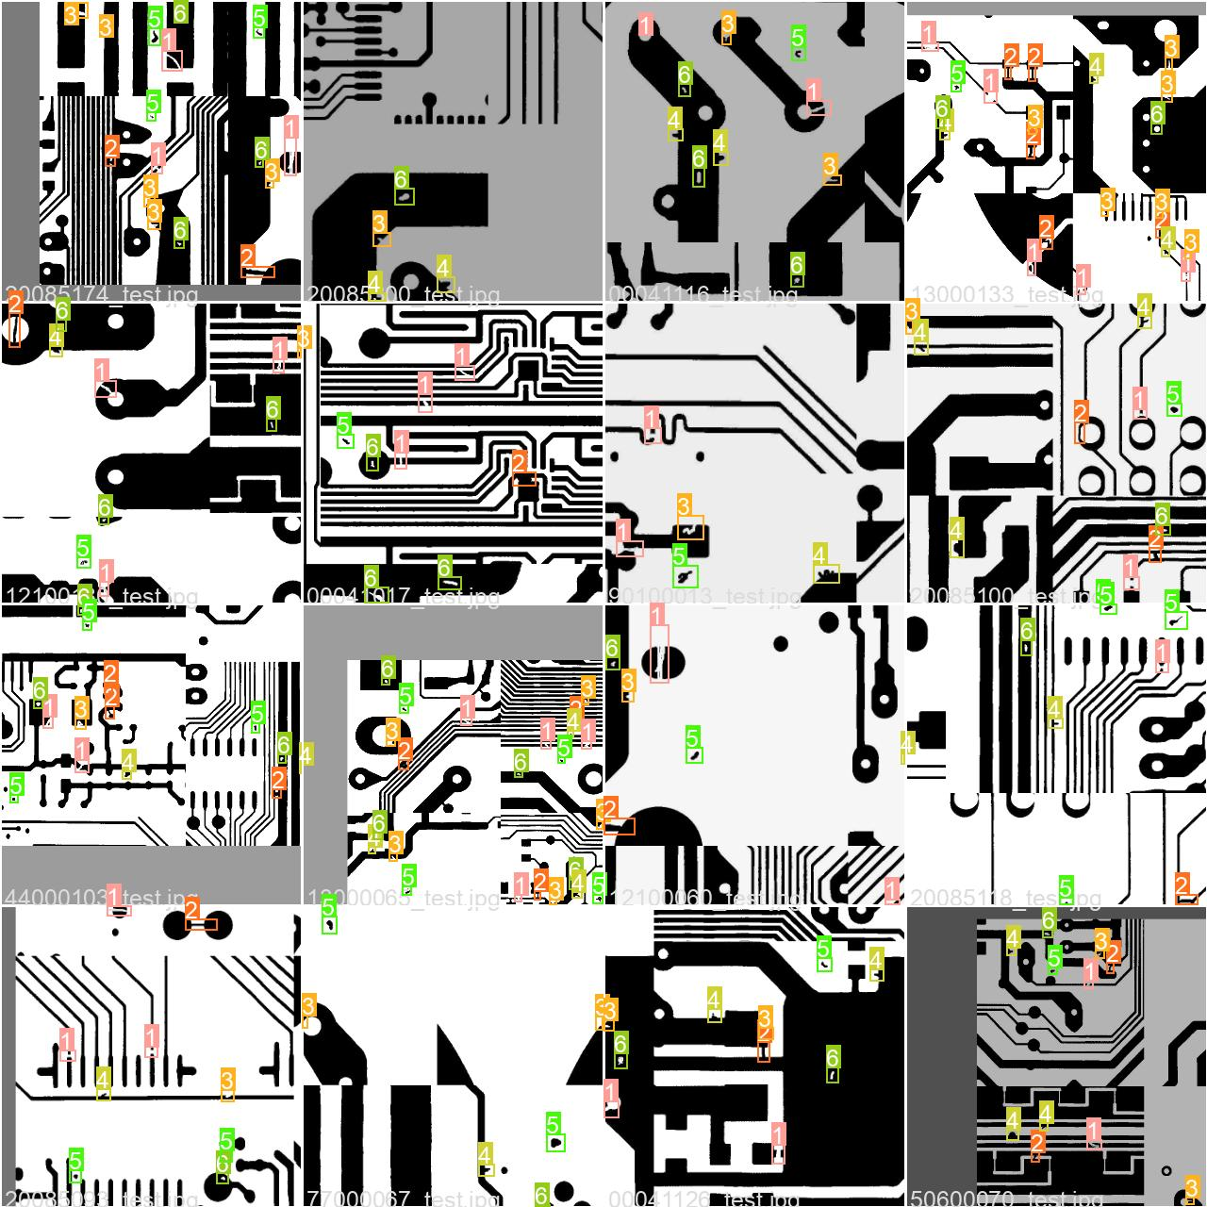
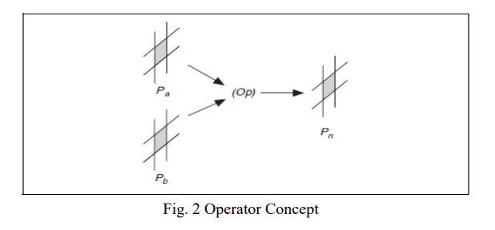

Innovation in Implementation
Previous implementations of this project extensively use OpenCV and image subtraction methods whereas I have used Machine Learning in order to identify anomaly in the PCBs.
This tremendously reduces any chance of errors that might occur during inspection. These capabilities help out solution to adapt to the changes and dynamic environment of the industry.
This is the only algorithm that is capable of managing web-app requests as well as real-time detection over incoming stream of images.

Slide 11
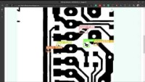
Outcome
PCB Fault Detection by Keivalya Pandya | INTP22-ML-3 IITD-AIA-FSM 2022 - YouTube
(Disclaimer: Video link is embedded to reduce presentation file size)
YouTube Link https://www.youtube.com/watch?v=zP__x9c0EuQ&ab_channel=KeivalyaPandya

Slide 12
Scalability
Scalability means transferring the project from local-level to adapting industrial expansion.
The deployed web-application has achieved the scalability where it can be used by numerous industries at the same time, on the online platform.
Apart from that, the offline real-time PCB fault detection can be operated on local machines for faster production lines.
In the future, I aim to develop a database which stores the defect/no-defect detection associated with each PCB examined by the system generating its own UUID (Unique ID).

Slide 13
Thank You
keivalyapandya2001@gmail.com

